Slide 1


DEPARTMENT OF COMPUTER SCIENCE AND ENGINEERING
(Artificial Intelligence And Machine Learning)
A.P Shah Institute of Technology
University Of Mumbai
Academic Year 2022-2023

Slide 2

ListenME: Twitter Like Microblogging App
GAURI GANDHI (21106002)
Rahil Shaikh (21106019)
Tejal Deshmukh (21106001)
UNDER THE GUIDANCE OF
Prof. Shraddha Shinde

Slide 3
INDEX
Overview
Objectives
Features/Literature Survey
Block Diagram
Tools/Software
Implementation
Conclusion
References

Slide 4
OVERVIEW
A Twitter Clone is a Web Application That Mimics the Functionality of Social Media Platform Twitter.
Tweet Creating and posting : Ability for user to create and post short messages .
User authentication and account creation : The ability for users to create accounts, login, and log-out.
User Profiles : The ability for users to view their own profiles, tweets as well as of other users.
Following and Followers : The ability for users to follow and be followed by others users and view the list of users they are following and who are following them.
Edit : To allow user to change their password, bio , Username , and profile picture

Slide 5
Objectives
1
LISTENME
To create a social media platform that mimics the core features of Twitter, including user authentication
2
To ensure the scalability and reliability of the platform, allowing for potential future growth and expansion.
3
Utilize various Django tools and technologies, including Django ORM, Django Forms, Django Templates, and Django Views to implement core Twitter features such as user profiles, tweets, likes, and follows.

Slide 6
Features
PAY
Authentication
Authentication is Implemented Using Django Built In authentication System, Authentication Views Used are Login, Logout, Sign UP
1
Tweet creation and posting
LISTENME
Ability for user to create and post short messages
2
Tweet Feed
3
This features allow users to view the feed of tweets from other users they follow
Following and Follow
4
The ability for users to follow and be followed by others users and view the list of users they are following and who are following them.

Slide 7
Literature Survey
Sr. No | Title | Author Name | Description
1. | Parler | Andy Biggs | Parler is another social media platform that has been described as a Twitter clone. Parler was launched in 2018 and gained popularity among conservative users. Parler has a similar user interface to Twitter and allows users to post messages up to 1,000 characters long. Like Gab, Parler has been criticized for allowing hate speech and extremist content on its platform.
2. | Twister | Noah Everett | Twister is a decentralized social media platform that is often compared to Twitter. Twister is based on the Bitcoin blockchain and allows users to post short messages to their followers. Twister's decentralized architecture makes it more difficult for governments and other entities to censor or control the platform.

Slide 8
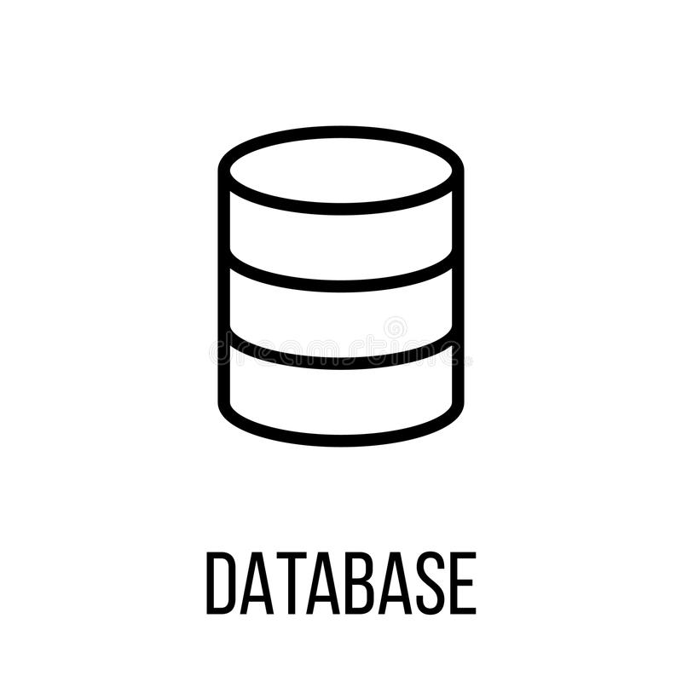

BLOCK DIAGRAM
Https Request/response
ID
Username
Password
Email
USER
USER
ID
Username
Content
Updated_at
Tweet
FrameWork
Web Application
ID
Username
Follower ID
Follower
ORM QUERIES

Slide 9
Tools Used
Django
Python
Django is a Python-based web framework with set of tools and libraries for web application
Python
Python is a computer programming language often used to built websites and Software, Automate task, and Data analysis
Django
FrameWork
CSS
Framework
Database
Database
Css
CSS Framework like Bootstrap to help Styling and layout the interface
Django has built-in database SQLite. We can define our own database schema using python classes and attributes rather than Sql command

Slide 10
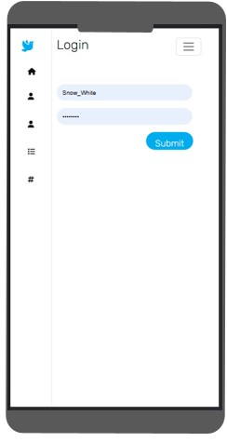
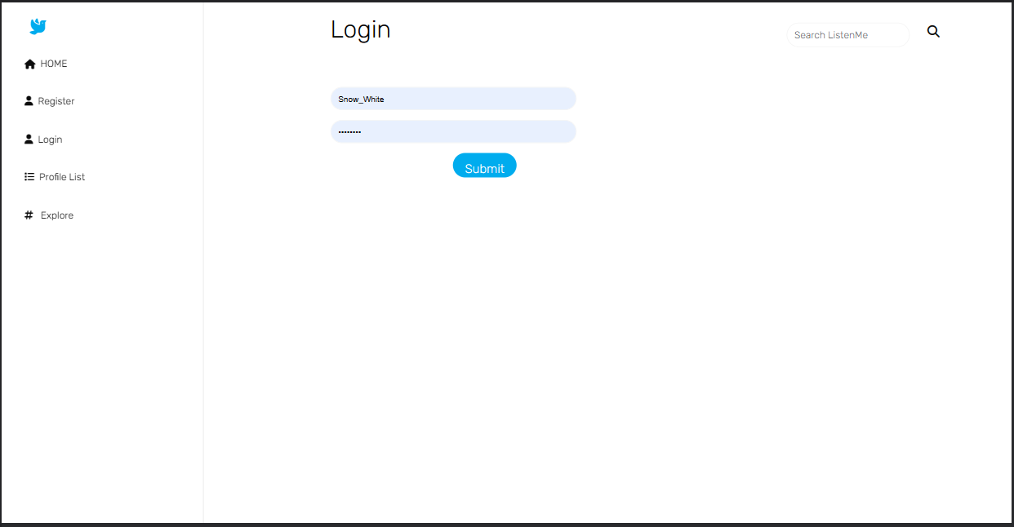
System Design
User Authenticatioin

Slide 11
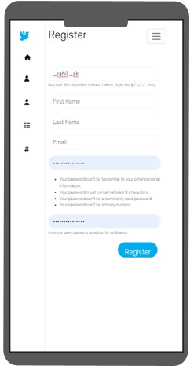
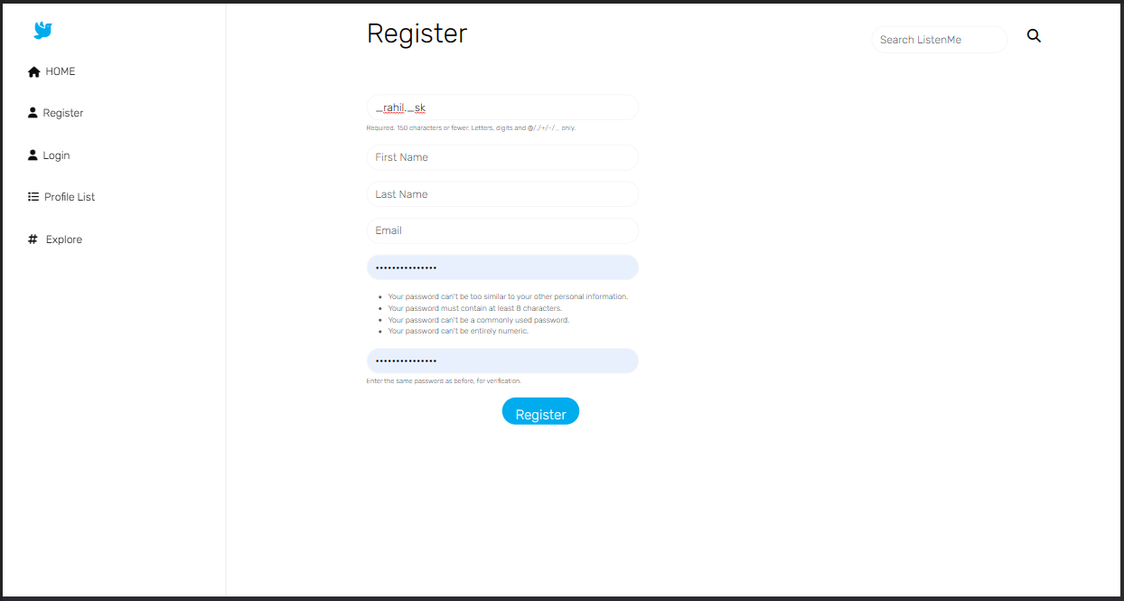
Registration -

Slide 12
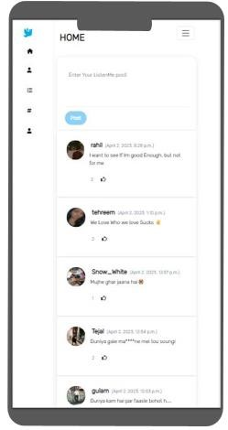
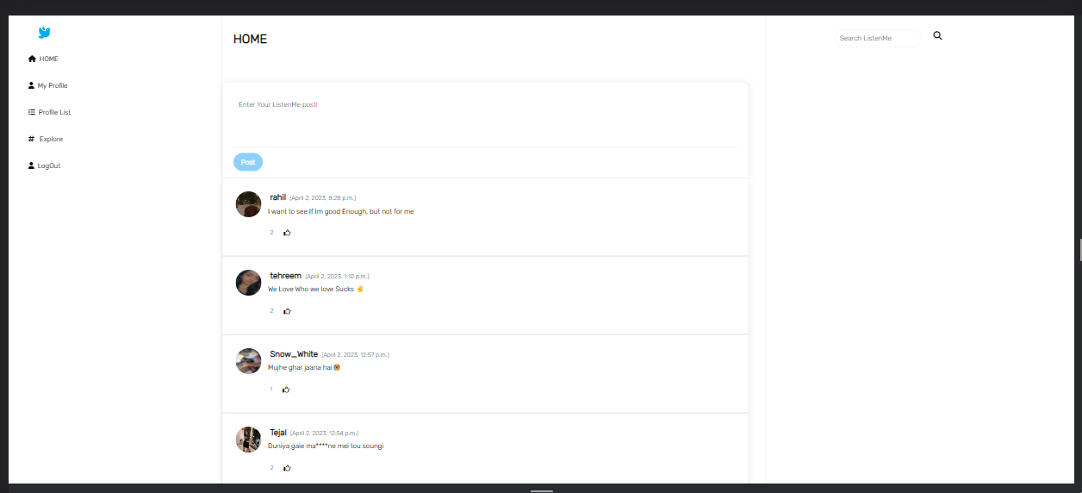
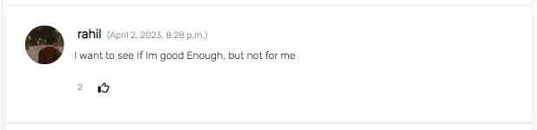
Home -

Slide 13
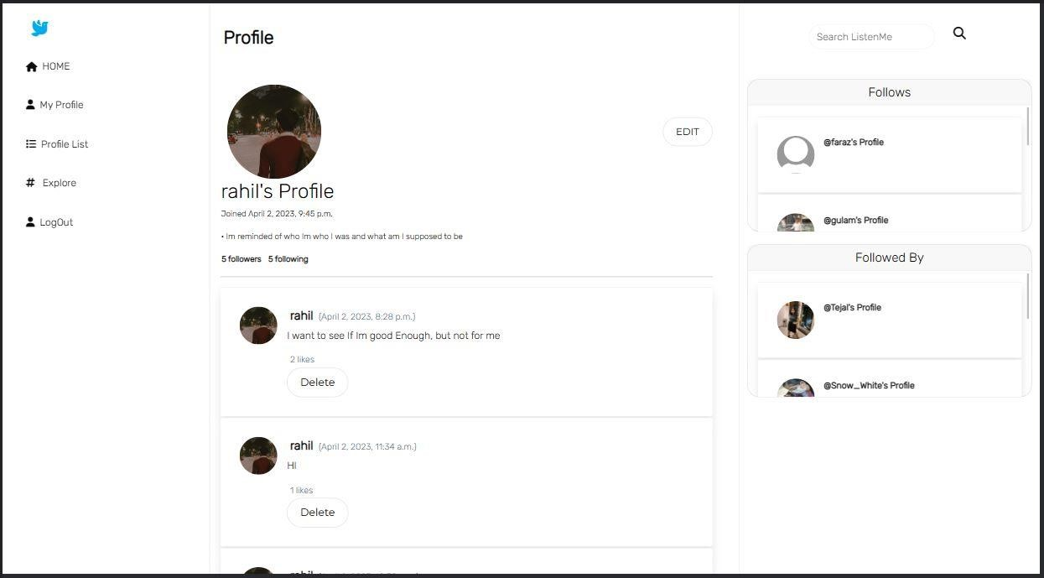
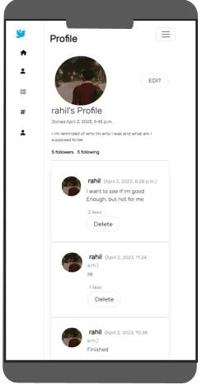
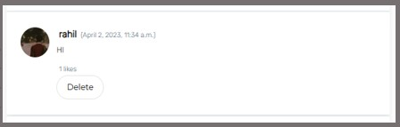
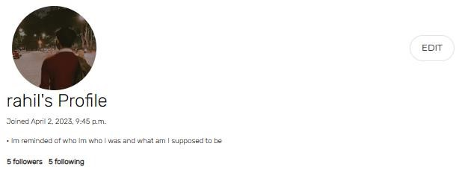
User Profile -

Slide 14
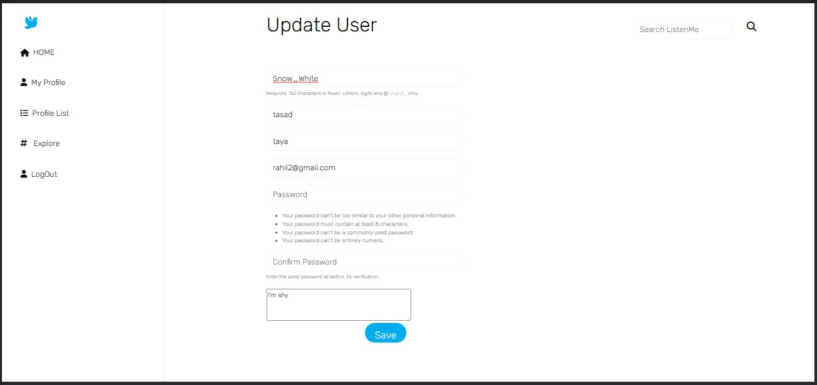
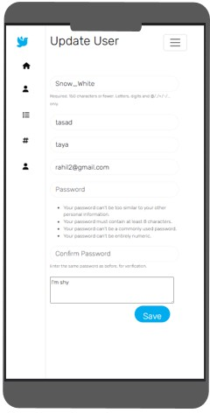
Edit Profile

Slide 15
Conclusion
The project involved the development of a microblogging web application using the Django framework. The application was designed to provide a platform for users to create and share posts, follow other users, and interact with their content through likes and comments.
The project was successful in achieving its objectives, and all the features were implemented as expected. The application was tested using appropriate test cases, and the results were analyzed using the parameters identified earlier.
The project has several contributions, including providing a learning platform for developing web applications using the Django framework, enhancing the understanding of microblogging applications and their functionalities, and providing a sample implementation of a microblogging application.
In conclusion, the project has achieved its objectives and demonstrated the feasibility of building a microblogging web application using the Django framework. The scope for future work includes enhancing the security features of the application, improving the user interface, and incorporating additional functionalities such as direct messaging and search functionality.

Slide 16
References
Srivastava, U., Khurana, A., & Bhatia, V. (2017). Twitter-like Microblogging Platform Using Django. International Conference on Computing and Network Communications.
"Building a Twitter Clone with React Native and Firebase" by Spencer Carli. This tutorial covers the creation of a Twitter-like mobile application using React Native and Firebase. It covers topics such as user authentication, creating tweets, following other users, and displaying a user's timeline. The tutorial can be found at https://learn.handlebarlabs.com/courses/build-a-twitter-clone-with-react-native-and-firebase.
“Building a Twitter Clone with Django" by Agiliq. This tutorial covers the creation of a Twitter-like web application using the Django web framework. It covers topics such as user authentication, creating tweets, following other users, and displaying a user's timeline. The tutorial can be found at https://www.agiliq.com/blog/2009/09/building-a-twitter-like-site-with-django/.
“Building a Twitter Clone in Django : A step-by-step tutorial”- https://learndjango.com/tutorials/building-a-twitter-clone-in-django .
How to Build a Twitter Clone using Python - https://www.freecodecamp.org/news/how-to-build-a-twitter-clone-using-python/ .

Slide 17
Thank You

